Slide 1
GA structures and parameters
Ziyu Zhou
06/08/2016

Slide 2
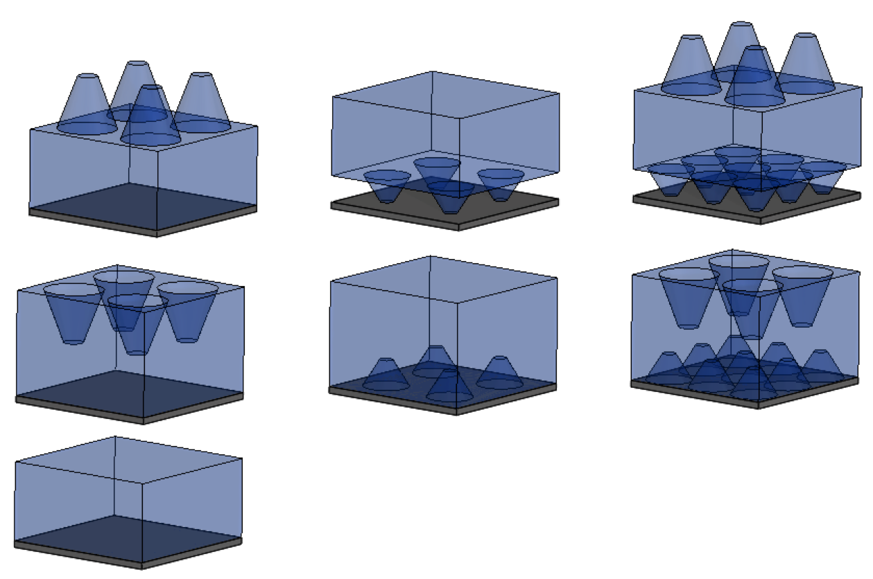
Schematic for 6 Optimized Structures
r_{top1}
a₁
(a)
(b)
(c)
r_{top1}
a₁
h₁
h₁
r_{bot1}
t
t
r_{bot1}
r_{top2}
r_{top2}
a₂
t
a₂
h₂
h₂
r_{bot2}
r_{bot2}
(d)
(e)
(f)
r_{top1}
a₁
r_{top1}
a₁
h₁
h₁
r_{bot1}
t
t
r_{top2}
a₂
t
r_{top2}
a₂
r_{bot1}
h₂
h₂
r_{bot2}
r_{bot2}
(g)
t_{eff}

